Slide 1

Database Systems
Lecture 8

Slide 2
Lecture Agenda
DDL (DATA DEFINITION LANGUAGE)
CREATE
ALTER
DROP
TRUNCATE
RENAME
COMMENT

Slide 3
Getting started with SQL

Slide 4
SQL Commands | DDL, DQL, DML, DCL and TCL Commands
SQL commands are extensively used to interact with databases, enabling users to perform a wide range of actions on database systems. Understanding these commands is crucial for effectively managing and manipulating data.
This guide will introduce you to the various SQL sublanguage commands, including Data Definition Language (DDL), Data Query Language (DQL), Data Manipulation Language (DML), Data Control Language (DCL), and Transaction Control Language (T

Slide 5
Short Overview of SQL
Structured Query Language (SQL), as we all know, is the database language by which we can perform certain operations on the existing database, and we can also use this language to create a database. SQL uses certain commands like CREATE, DROP, INSERT, etc. to carry out the required tasks.
SQL Commands are like instructions to a table. It is used to interact with the database with some operations. It is also used to perform specific tasks, functions, and queries of data. SQL can perform various tasks like creating a table, adding data to tables, dropping the table, modifying the table, set permission for users.

Slide 6
SQL Commands
SQL Commands are mainly categorized into five categories:
DDL – Data Definition Language
DQL – Data Query Language
DML – Data Manipulation Language
DCL – Data Control Language
TCL – Transaction Control Language

Slide 7
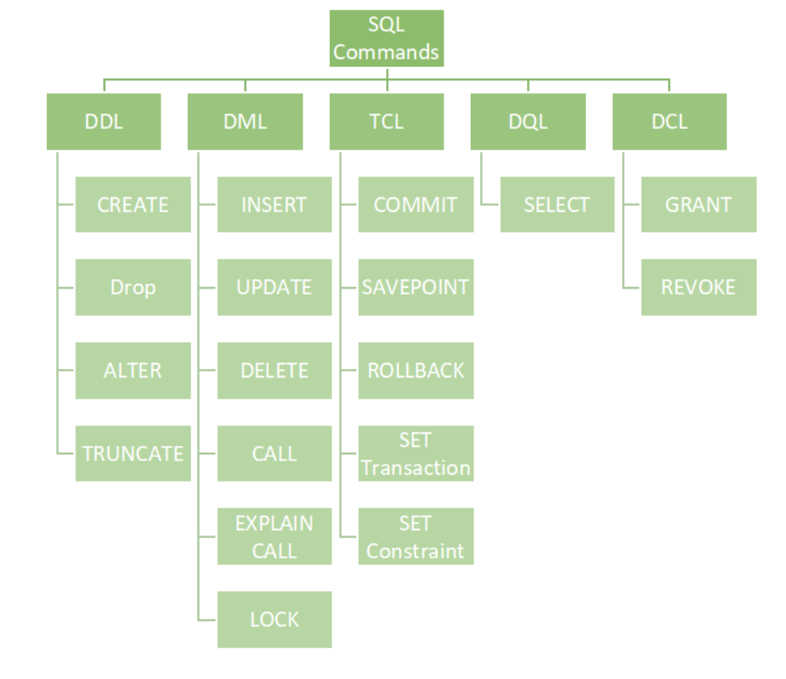

Slide 8
Data Definition Language

Slide 9
List of DDL Commands:
CREATE
ALTER
DROP
TRUNCATE
RENAME
COMMENT

Slide 10
CREATE COMMAND

Slide 11
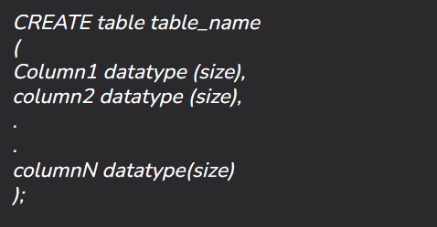
Syntax

Slide 12
CREATE COMMAND - CONSTRAINTS

Slide 13
CREATE – PRIMARY KEY CONSTRAINT
CREATE TABLE Employee (
EmployeeID INT PRIMARY KEY,
FirstName VARCHAR(50),
LastName VARCHAR(50),
Department VARCHAR(50),
Salary DECIMAL(10, 2)
);

Slide 14
CREATE - NOT NULL CONSTRAINT
CREATE TABLE Employee (
EmployeeID INT PRIMARY KEY,
FirstName VARCHAR(50) NOT NULL,
LastName VARCHAR(50) NOT NULL,
Department VARCHAR(50) NOT NULL,
Salary DECIMAL(10, 2) NOT NULL
);

Slide 15
CREATE – UNIQUE CONSTRAINT:
1. What is a Unique Constraint?
Ensures that all values in a column (or a combination of columns) are unique across rows.
Prevents duplicate entries in specified columns.
2. How to Define a Unique Constraint in SQL
Example Table Creation:
CREATE TABLE Employee ( EmployeeID INT PRIMARY KEY,
FirstName VARCHAR2(50) NOT NULL,
LastName VARCHAR2(50) NOT NULL,
Department VARCHAR2(50) NOT NULL,
Salary DECIMAL(10, 2) NOT NULL,
Email VARCHAR2(100) UNIQUE );

Slide 16
UNIQUE CONSTRAINT ON MULTIPLE COLUMNS
INLINE
END OF DEFINITION

Slide 17
Defining Unique Constraints on Multiple Columns:
CREATE TABLE Employee ( EmployeeID INT PRIMARY KEY,
FirstName VARCHAR2(50) NOT NULL,
LastName VARCHAR2(50) NOT NULL,
Department VARCHAR2(50) NOT NULL,
Salary DECIMAL(10, 2) NOT NULL,
UNIQUE (FirstName, LastName) );

Slide 18
Adding a constraint name
CREATE TABLE Employees (
EmployeeID INT PRIMARY KEY,
FirstName VARCHAR2(50),
LastName VARCHAR2(50),
Email VARCHAR2(100),
DepartmentID INT,
CONSTRAINT unique_name_email UNIQUE (FirstName, LastName, Email)
);

Slide 19
Inline Unique Constraint
When you specify the unique constraint inline with the columns, you clearly indicate which columns are part of that constraint right where the columns are defined. This can improve readability and make it easier to understand the structure of the table at a glance.
CREATE TABLE Employee (
EmployeeID INT PRIMARY KEY,
FirstName VARCHAR2(50) NOT NULL,
LastName VARCHAR2(50) NOT NULL,
Department VARCHAR2(50) NOT NULL,
Salary DECIMAL(10, 2) NOT NULL,
Email VARCHAR2(100) UNIQUE,
Phone VARCHAR2(15) UNIQUE
);

Slide 20
End-of-Definition Unique Constraint
Placing the unique constraint at the end allows for a cleaner separation of column definitions and constraints. This approach can be useful if you have multiple constraints to define and want to keep the main structure of the table focused on the columns themselves.
CREATE TABLE Employee (
EmployeeID INT PRIMARY KEY,
FirstName VARCHAR2(50) NOT NULL,
LastName VARCHAR2(50) NOT NULL,
Department VARCHAR2(50) NOT NULL,
Salary DECIMAL(10, 2) NOT NULL,
UNIQUE (FirstName, LastName),
UNIQUE (Email)
);

Slide 21
CREATE - FOREIGN KEY CONSTRAINT
Establishes a relationship between two tables, ensuring that the value in one table corresponds to a valid value in another.
FOREIGN KEY (DepartmentID) REFERENCES Departments(DepartmentID)

Slide 22
CREATE - CHECK CONSTRAINT
Ensures that the values in a column satisfy a specific condition.
CHECK (Salary > 0)

Slide 23
CHECK CONTRAINT - EXAMPLE
CREATE TABLE Employee (
EmployeeID INT PRIMARY KEY,
FirstName VARCHAR2(50) NOT NULL,
LastName VARCHAR2(50) NOT NULL,
Salary DECIMAL(10, 2) CHECK (Salary > 0)
);
In this example, the CHECK constraint ensures that any salary entered must be greater than zero.

Slide 24
EXAMPLE OF A CREATE TABLE STATEMENT WITH CONSTRAINTS
CREATE TABLE Employee (
EmployeeID INT PRIMARY KEY,
FirstName VARCHAR2(50) NOT NULL,
LastName VARCHAR2(50) NOT NULL,
DepartmentID INT,
Email VARCHAR2(100) UNIQUE,
Salary DECIMAL(10, 2) CHECK (Salary > 0),
FOREIGN KEY (DepartmentID) REFERENCES Departments(DepartmentID)
);

Slide 25
List of DDL Commands:
CREATE
ALTER
DROP
TRUNCATE
RENAME
COMMENT

Slide 26
DDL – ALTER

Slide 27
Key Operations with ALTER
Add a Column
Drop a Column
Modify a Column
Rename a Column
Add/Drop Constraints

Slide 28
Syntax Overview - Add a Column
ALTER TABLE table_name ADD column_name datatype [constraints];

Slide 29
Example 1: Add a Column
Task: Add a new column email to the employes table.
SQL Command
ALTER TABLE employees ADD email VARCHAR2(100);

Slide 30
Syntax Overview - Drop a Column
ALTER TABLE table_name DROP COLUMN column_name;

Slide 31
Example 2: Drop a Column
Task: Remove the email column from the employees table.
SQL Command
ALTER TABLE employees DROP COLUMN email;

Slide 32
Syntax Overview - Modify a Column
ALTER TABLE table_name MODIFY column_name new_datatype [constraints];

Slide 33
Example 3: Modify a Column
Task: Change the datatype of the salary column from NUMBER to FLOAT.
SQL Command
ALTER TABLE employees MODIFY salary FLOAT;

Slide 34
Syntax Overview - Rename a Column
ALTER TABLE table_name RENAME COLUMN old_column_name TO new_column_name;

Slide 35
Example 4: Rename a Column
Task: Rename the hire_date column to date_hired.
SQL Command
ALTER TABLE employees RENAME COLUMN hire_date TO date_hired;

Slide 36
Syntax Overview - Add/Drop Constraints a Column
ALTER TABLE table_name ADD CONSTRAINT constraint_name constraint_type (column_name);
ALTER TABLE table_name DROP CONSTRAINT constraint_name;

Slide 37
Example 5: Add a Constraint
Task: Add a UNIQUE constraint to the email column in the employees table.
SQL Command
ALTER TABLE employees ADD CONSTRAINT unique_email UNIQUE (email);

Slide 38
Example 6: Drop a Constraint
Task: Remove the UNIQUE constraint from the email column.
SQL Command:
ALTER TABLE employees DROP CONSTRAINT unique_email;

Slide 39
Example 7: Rename a Table
Task: Rename the employees table to staff.
SQL Command
ALTER TABLE employees RENAME TO staff;

Slide 40
Example 8: Change Default Value
Task: Set a default value of 0 for the salary column.
SQL Command
ALTER TABLE employees MODIFY salary DEFAULT 0;

Slide 41
Example 9: Add a Check Constraint
Task: Add a CHECK constraint to ensure the salary is greater than 0.
SQL Command:
ALTER TABLE employees ADD CONSTRAINT check_salary CHECK (salary > 0);

Slide 42
List of DDL Commands:
CREATE
ALTER
DROP
TRUNCATE
RENAME
COMMENT

Slide 43
DDL – DROP & TRUNCATE

Slide 44
DROP and TRUNCATE
In Oracle 10g, both the DROP and TRUNCATE commands are Data Definition Language (DDL) commands used to manage database objects, but they serve different purposes. Here’s a detailed explanation of each command

Slide 45
What is DROP Command?
DROP command in SQL is used to delete a whole database or a table.
DROP statement deletes objects like an existing database, table, index, or view.
Syntax
DROP object object_name ;
Example
DROP TABLE employees;
This command will remove the employees table from the database along with all its data and structure.

Slide 46
DROP Command Examples
DROP Table
Syntax
DROP TABLE table_name;
DROP database
Syntax:
DROP DATABASE database_name;

Slide 47
What is TRUNCATE Command?
TRUNCATE statement is a Data Definition Language (DDL) operation that is used to mark the extent of a table for deallocation (empty for reuse). The result of this operation quickly removes all data from a table, typically bypassing several integrity-enforcing mechanisms.
Syntax
TRUNCATE TABLE table_name;

Slide 48
List of DDL Commands:
CREATE
ALTER
DROP
TRUNCATE
RENAME
COMMENT

Slide 49
DDL – RENAME

Slide 50
DDL-RENAME
To rename a table in SQL using the ALTER TABLE command, you can use the RENAME statement. Here’s the syntax for renaming a table in Oracle SQL:
SYNTAX
ALTER TABLE old_table_name
RENAME TO new_table_name;
ExampleIf you have a table named Lecture8 and you want to rename it to LectureCourse, you would use:
ALTER TABLE Lecture8
RENAME TO LectureCourse;

Slide 51
List of DDL Commands:
CREATE
ALTER
DROP
TRUNCATE
RENAME
COMMENT

Slide 52
DDL – COMMENT

Slide 53
DDL-COMMENT
In SQL, the COMMENT command is used to add comments or descriptions to database objects such as tables, columns, views, and more. This is helpful for documentation purposes and to provide context for future users.Syntax for Adding a CommentTo add a comment to a table or column in Oracle, you can use the following syntax:
Adding a Comment to a Table
COMMENT ON TABLE table_name IS 'Your comment here';
Adding a Comment to a Column
COMMENT ON COLUMN table_name.column_name IS 'Your comment here';

Slide 54
Retrieving Comments
ADDING COMMENT:
COMMENT ON TABLE Lecture8 IS 'This table stores information about lectures.';
COMMENT ON COLUMN Lecture8.topicname IS 'The name of the lecture.’;
RETRIEVING COMMENT:
SELECT * FROM USER_TAB_COMMENTS WHERE TABLE_NAME = 'LECTURE8’;
SELECT * FROM USER_COL_COMMENTS WHERE TABLE_NAME = 'LECTURE8';

Slide 55
DQL-DATA QUERY LANGUAGE
1. SELECT

Slide 56
DQL - SELECT

Slide 57
DQL-SELECT
The SELECT statement is a fundamental part of SQL used to query and retrieve data from a database. Here’s a comprehensive overview of its components and functionalities.
Basic Syntax:
SELECT column1, column2, ...
FROM table_name
WHERE condition;

Slide 58
Components of the SELECT Statement
SELECT Clause:
Specifies the columns to be retrieved. You can use:
Specific column names: SELECT column1, column2
* to select all columns: SELECT *
FROM Clause:
Indicates the table(s) from which to retrieve data.
WHERE Clause:
Filters records based on specified conditions. It is optional.
Example: WHERE column1 = value

Slide 59
Components of the SELECT Statement..cont
ORDER BY Clause:
Sorts the result set based on one or more columns. You can specify ascending (ASC) or descending (DESC) order.
Example: ORDER BY column1 ASC, column2 DESC
GROUP BY Clause:
Groups rows sharing a property so that aggregate functions (like SUM, AVG, etc.) can be applied.
Example: GROUP BY column1
HAVING Clause:
Filters groups based on aggregate functions. It is often used with GROUP BY.
Example: HAVING COUNT(column1) > 1

Slide 60
Components of the SELECT Statement..cont
JOIN Clause:
Combines rows from two or more tables based on a related column.
Types of joins include:
INNER JOIN: Returns records that have matching values in both tables.
LEFT JOIN (OUTER): Returns all records from the left table and matched records from the right table.
RIGHT JOIN (OUTER): Returns all records from the right table and matched records from the left table.
FULL OUTER JOIN: Returns records when there is a match in either table.

Slide 61
Take home activity:
1. Search for the difference between varchar and varchar2 yourself.

Slide 62
References:
https://www.geeksforgeeks.org/types-of-keys-in-relational-model-candidate-super-primary-alternate-and-foreign/
https://www.geeksforgeeks.org/sql-ddl-dql-dml-dcl-tcl-commands/
https://www.w3resource.com/oracle/oracle-data-types.php
https://www.w3schools.com/sql/sql_datatypes.asp

